Slide 1
Scanner Problem Set
Mark Louis Lim S12

Slide 2
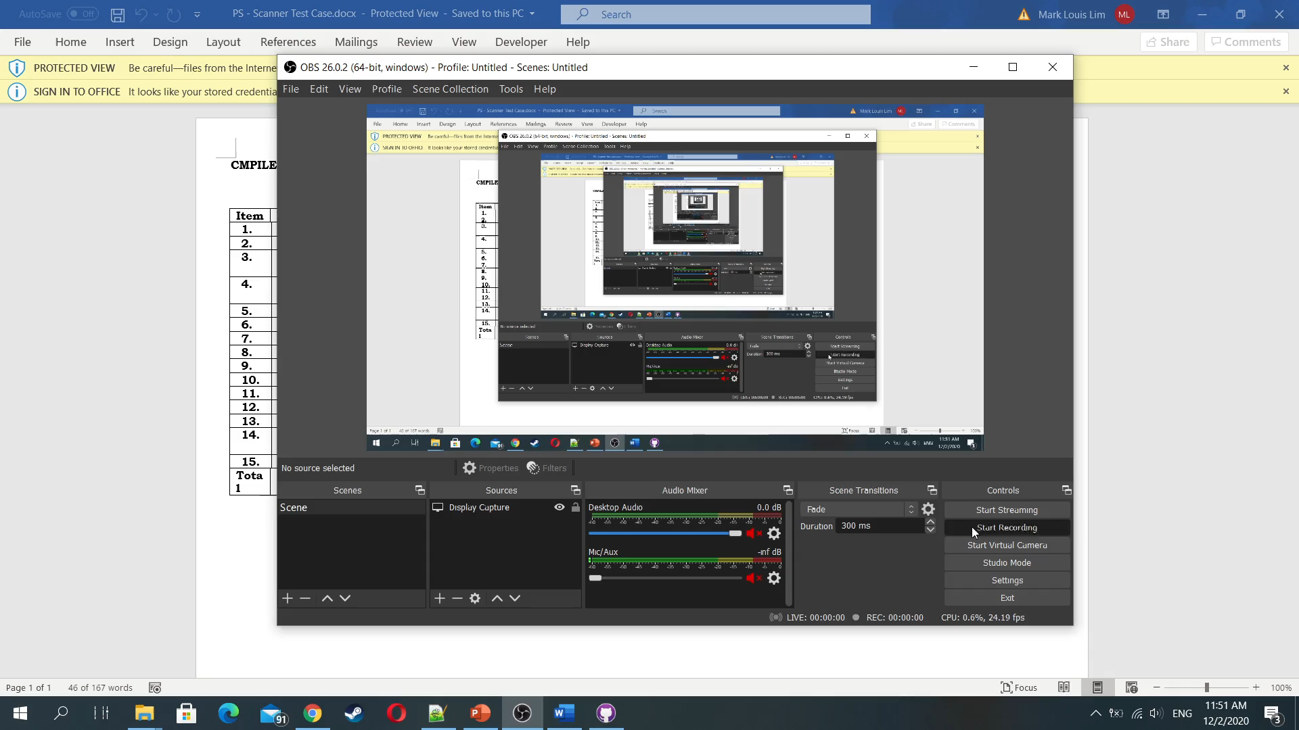
Test Case

Slide 3
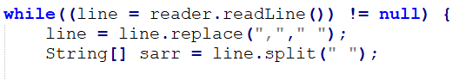
Token handling
Lines are read at a time with .readLine()
Split using the <whitespace> delimiter
Tokens with leading and trailing commas are removed with .replace(“,”)

Slide 4
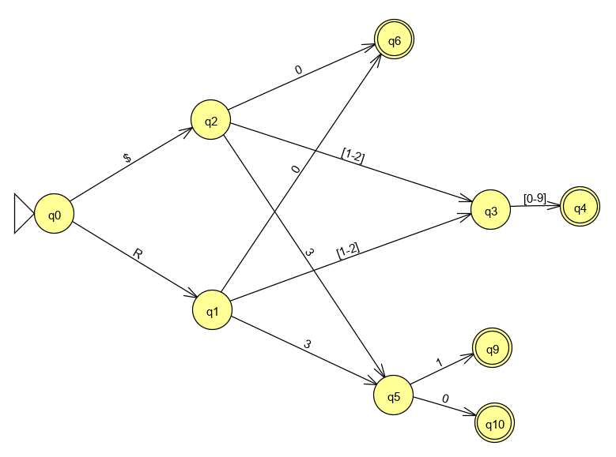
GPR DFA
Regex equivalent:
[R$]([0-9]|[12][0-9]|3[01])

Slide 5
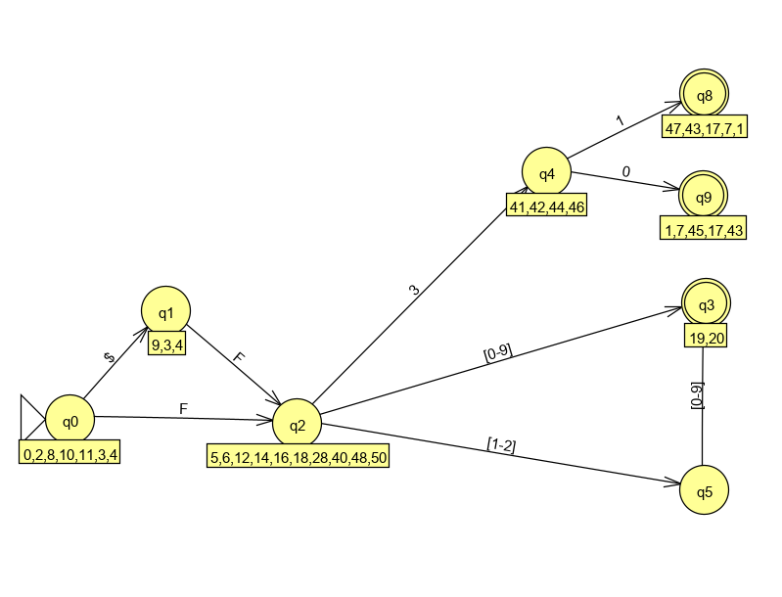
FPR DFA
Regex equivalent:
[$]?F([0-9]|[12][0-9]|3[01])\b

Slide 6
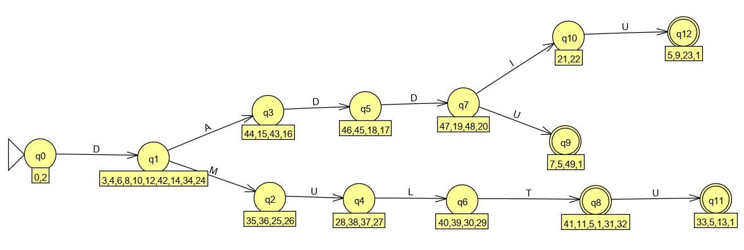
Keyword DFA
Regex equivalent:
D(ADDI?U|MULTU?)\b

Slide 7
Combined
GFA
$ | R
ε
S
$ | F
ε
A
NFA
D
ε
KEYWORD
This is what the code structure is meant to represent

Slide 8
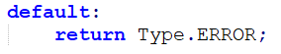
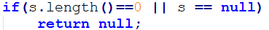
Unknown Tokens
All unknown tokens are identified with ERROR token type
This does not include empty strings or newlines which return null

